Slide 1

HCT NLP Week 3
问答摘要与推理
Seq2Seq（一）

Slide 2
Outline
Encoder-Decoder结构
Attention机制
模型Layer、Model构建
Seq2Seq训练

Slide 3
Outline
Encoder-Decoder结构
Attention机制
模型Layer、Model构建
Seq2Seq训练

Slide 4
Seq2Seq
Encoder-Decoder结构
Sequence to sequence was first introduced by Google in 2014

Slide 5
Seq2Seq
Encoder-Decoder结构

Slide 6
Seq2Seq
Encoder-Decoder结构

Slide 7
Seq2Seq
Encoder-Decoder结构

Slide 8
Seq2Seq
Encoder-Decoder结构
(source: Jay. Alammar, 2018)

Slide 9
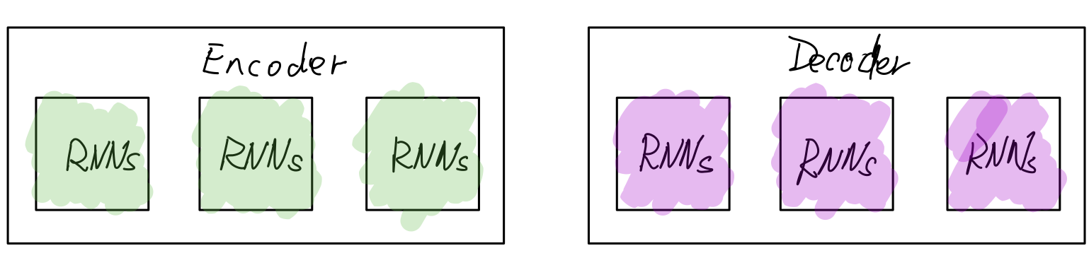
Seq2Seq
Encoder-Decoder结构

Slide 10
Outline
Encoder-Decoder结构
Attention机制
模型Layer、Model构建
Seq2Seq训练

Slide 11
Attention机制

Slide 12
Attention机制

Slide 13
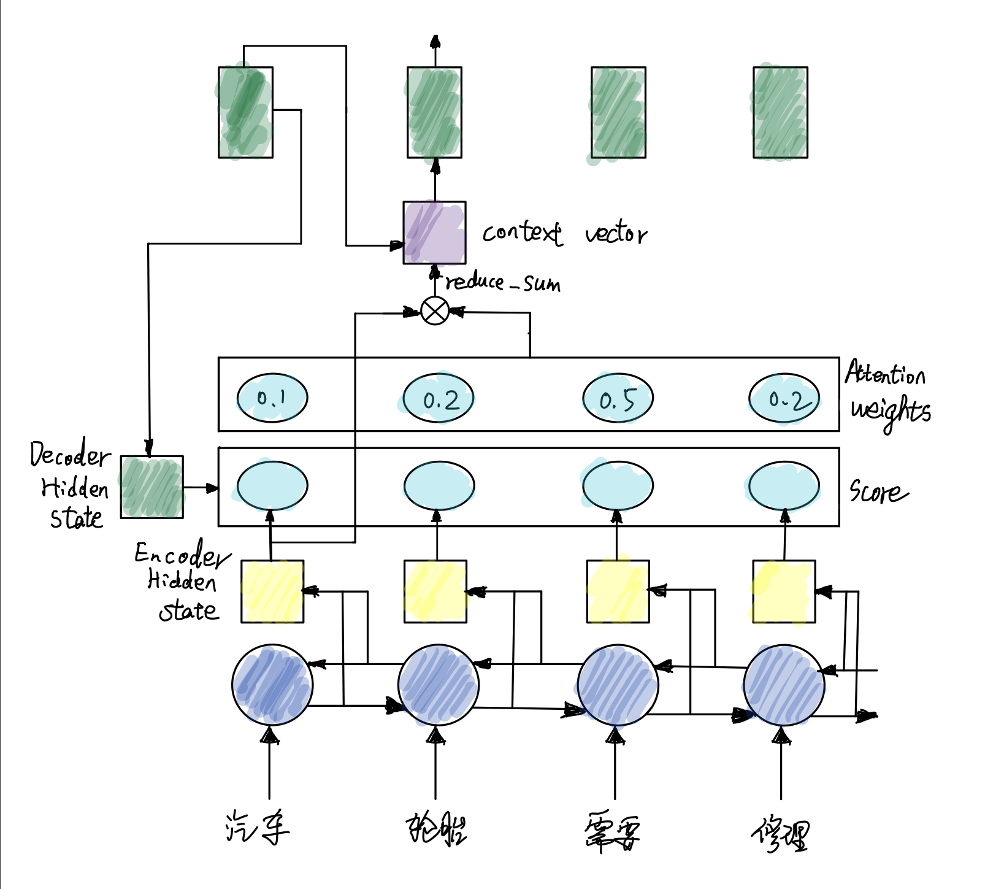

Slide 15
Outline
Encoder-Decoder结构
Attention机制
模型Layer、Model构建
Seq2Seq训练

Slide 16
模型Layer、Model构建
代码见jupyter

Slide 17
Outline
Encoder-Decoder结构
Attention机制
模型Layer、Model构建
Seq2Seq训练

Slide 18
Seq2Seq训练
How is it trained?

Slide 19
Seq2Seq训练
cross-entropy loss 交叉熵

Slide 20
Seq2Seq训练
cross-entropy loss 交叉熵

Slide 21
Seq2Seq训练
Teacher Forcing
RNN模型是用前一步的输出作为输入
Teacher Forcing方法能够解决收敛速度慢和不稳定的问题
Extensions to Teacher Forcing

Slide 22
Seq2Seq训练
Teacher Forcing

Slide 23
Seq2Seq训练
Exposure Bias

Slide 24
作业

Slide 25
Bye ！

